Slide 1







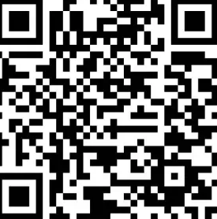


Generous - Commerce Connectors
Melvin Agram
Recorder & UX Lead
Mark Johnson
Release Manager
Asher Romanenghi
Team Lead
Tyler Sturm
Repo & Test Lead
Sponsored by:
Kyle Montgomery
Mentored by:
Nazmul Hossain

Slide 2



Gifts are one of the 5 major love languages
Hundreds of millions of people share gifts every year
It can feel impossible to find the right gift

Slide 3
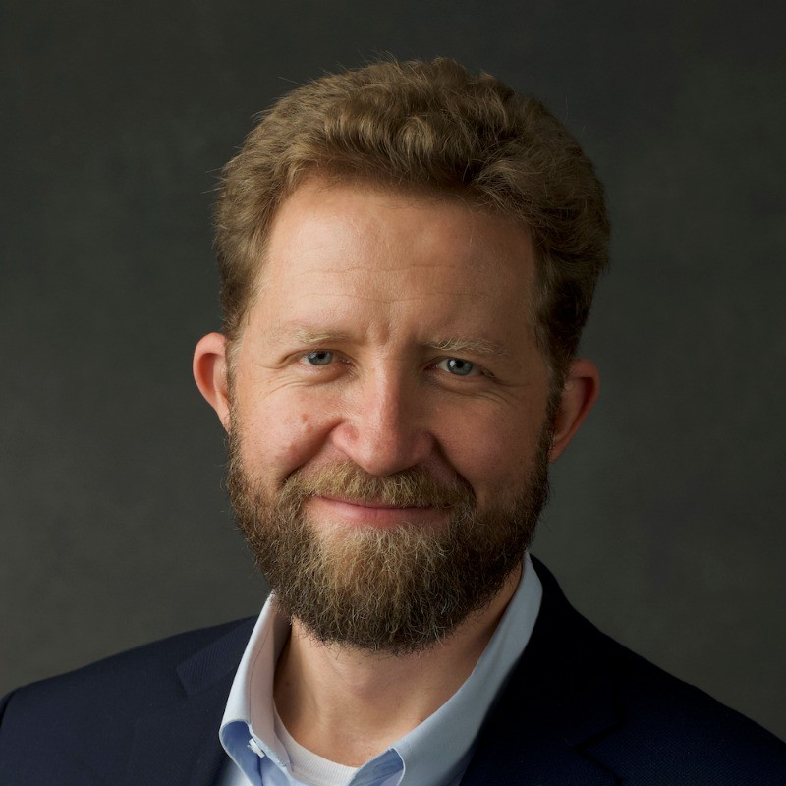
Sponsor
Kyle Montgomery
CEO & Co-Founder of Generous
Agentic commerce

Slide 4




Problem/Challenges
Manual & slow cataloging
No standardized way to receive product info from retailers
No direct order flow to retailers
Notes:
Currently product info is being catalogued manually (slow and not real time)
There's no easy way to receive product info from different retailers due to different schemas
No way to interact with MCPs
No way for retailers to receive orders from generous

Slide 5


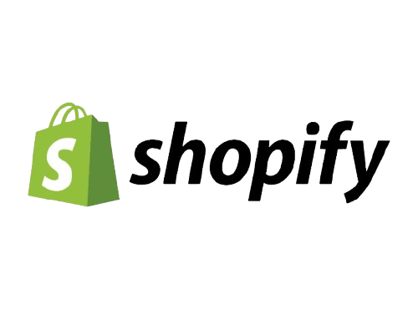
Solution Overview
One click upload
Retailer Specific Connectors
Dashboard integration
Notes:
Reusable SDK (Software Development Kit)
-Universal Tools (efficent brand onboarding)
-Base functions (catalogs, orders, payments, etc)
-Allows scaling (critical for growth)
Platform Specific Connectors
- Handle brand specific requirements
-”Speak the language” of platform API
A.I. MCP integration
-Adding context to API calls
We are all about Breadth
More connectors = more brands = more products = more gifts

Slide 6
Dashboard features
Checkbox interface
Frequency configuration
Notes:
Currently product info is being catalogued manually (slow and not real time)
There's no easy way to receive product info from different retailers due to different schemas
No way to interact with MCPs
No way for retailers to receive orders from generous

Slide 7
Solution Challenges
Differing Data Models
Security Compliance
Approval and Distribution
Versioning and Updates
Notes:
Currently product info is being catalogued manually (slow and not real time)
There's no easy way to receive product info from different retailers due to different schemas
No way to interact with MCPs
No way for retailers to receive orders from generous

Slide 8
Project Risks (with Mitigation)
Integration Complexity
Data Consistency Risks
Scope Creep
Security Vulnerabilities
Notes:
Integration Complexity: APIs may behave differently than expected — early testing + talking with support helps catch issues fast.
Data Consistency: Sync errors can cause missing or duplicated catalog data.
Scope Creep: Extra feature requests can push us past our timeline.
Security Risks: Bad auth or exposed endpoints could leak sensitive data.
Mitigation: Keep integration minimal and use sandbox environments throughout development.

Slide 9



Feasibility Analysis
Technical Feasibility
Architecture Feasibility
Team Feasibility
Notes:
Feasibility Check: We confirmed we can build a Salesforce Commerce Cloud cartridge using the Social Integrations cartridge as our base.
Data Access: Sandboxes give us all the product, inventory, and price data we need for the first demo.
Export + Format: We can pull that data out and format it for Generous using custom controllers and Business Manager configs.
Why Social Integrations Helps: It already has working examples of controllers, jobs, and configs—so we extend instead of building from scratch.
Mapping Simplicity: Categories, variants, and pricing map cleanly into the Generous schema.
Team Learning: We started with no SFCC experience but are learning fast through Trailhead, docs, and sandbox work.
Overall: With the reference cartridge and our progress, the project is very achievable this semester.

Slide 10
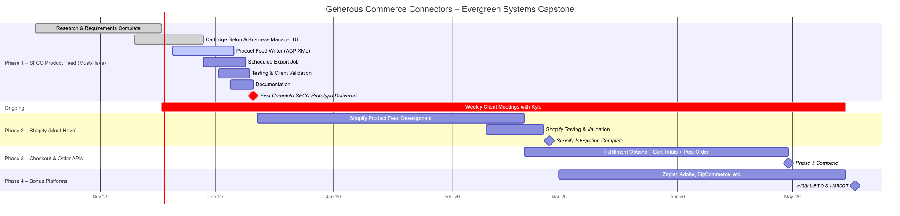
Schedule
December - First Complete Prototype Plugin (based on Salesforce)
February - Shopify Integration
Feb-May - Zapier, Adobe Commerce, etc
Weekly meetings with Kyle Montgomery (Status updates, design reworks, validation, feedback, etc)

Slide 11
Conclusions
Conclusion 1:
For everyone, Generous will make the gifting process easier
Conclusion 2:
For digital storefronts, Generous will provide a new source of revenue
Conclusion 3:
Our process will now be streamlined, scalable, and automated for catalog integration into Generous’s A.I.

Slide 12
THANK YOU

